Slide 1
Intro to Satellite Imagery
Credit for Content belongs to:
Marcos de Jesus & Mo Fotouhi

Slide 2
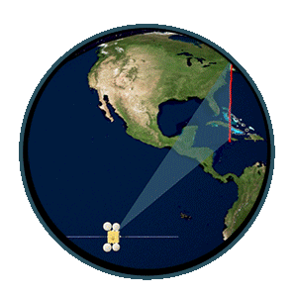
Satellite Imagery Overview
Remote Sensing
Acquiring information from a distance.
Earth and other planets are observed via remote sensors on satellites.
Sensors detect and record reflected or emitted electromagnetic energy.
Remote sensors provide:
Global perspective
Wealth of data
Enable data-informed decision making based on the current and future state of our planet.
Credit: Nasa Earth Data

Slide 3
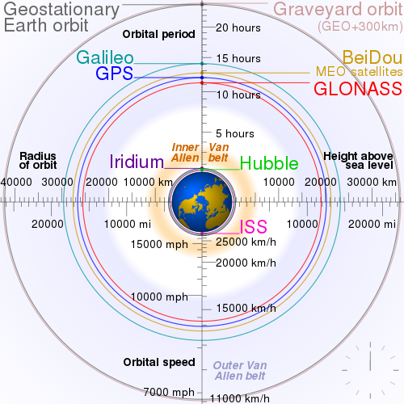
Satellite Imagery Overview
Orbits
Different orbit altitudes have different applications
Low orbit
180 km – 2,000 km
Orbit time of 128 minute or less
Remote Sensing(Planet and Sentinel)
Medium orbit
2,000 km – 35,786 km(Geostationary orbit)
Orbit time of 24 hours or less
GPS and communication
High orbit
> 35,786 km
Orbit time of more than 24 hours
Space exploration
By cmglee - Own work, CC BY-SA 3.0, https://commons.wikimedia.org/w/index.php?curid=16891766

Slide 4
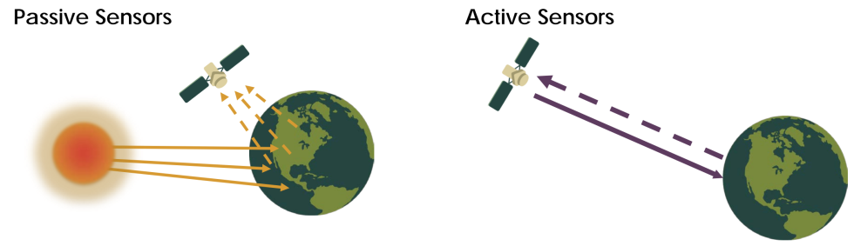
Satellite Imagery Overview
Sensors
Sun as source of illumination
Visible, infrared, thermal infrared, and microwave spectrum
Measure
Land and sea surface temperature
Vegetation Properties
Imagery
Own source of illumination
Microwave spectrum
Measure:
Vegetation structure
Topography
Sea-ice mapping

Slide 5
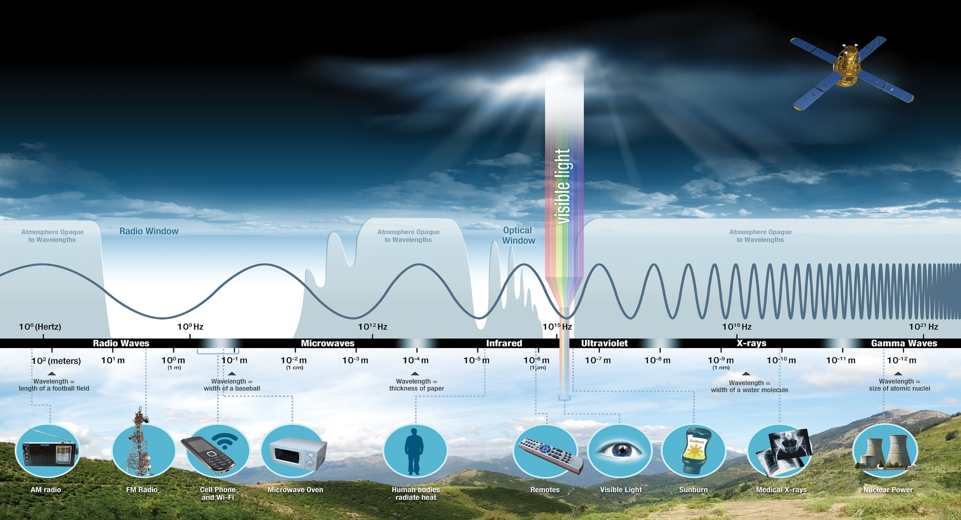
Satellite Imagery Overview
Observing with the electromagnetic spectrum

Slide 6
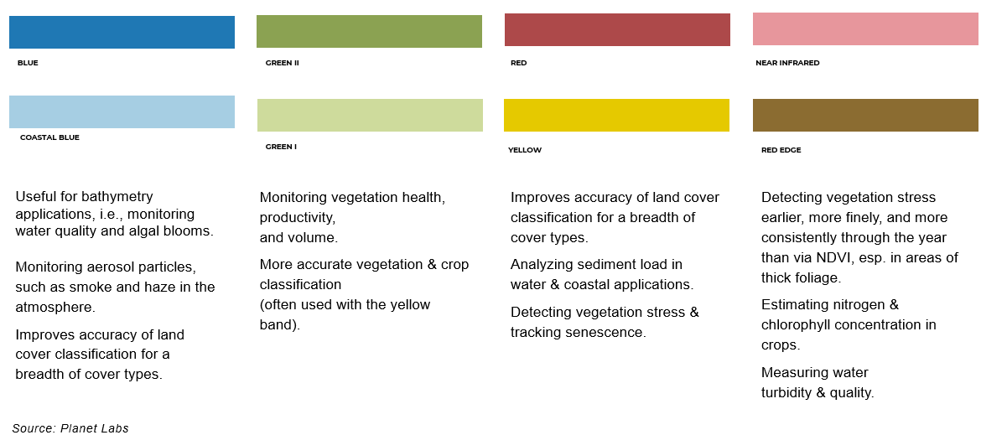
Satellite Imagery Overview
Multiple observed characteristics

Slide 7
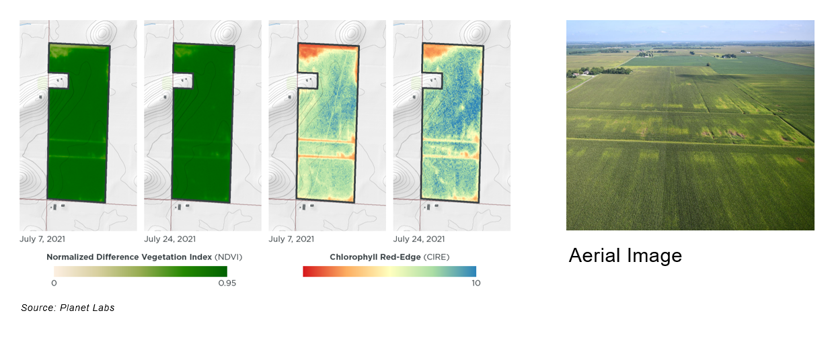
Satellite Imagery Overview
Red Edge Band

Slide 8
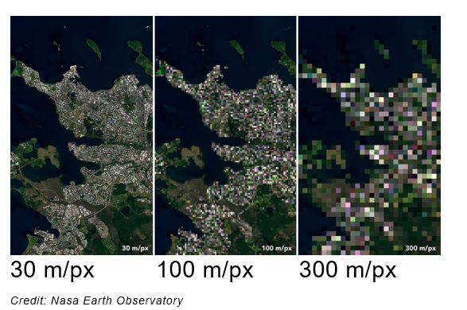

Satellite Imagery Overview
Resolution
Temporal Resolution
The time it takes for a satellite to revisit the the same observation area
Spatial Resolution
Size of each pixel within the image and the area on Earth’s surface represented by it
Lower number = More detail
Metop Orbit. Credit: EUMETSAT

Slide 9
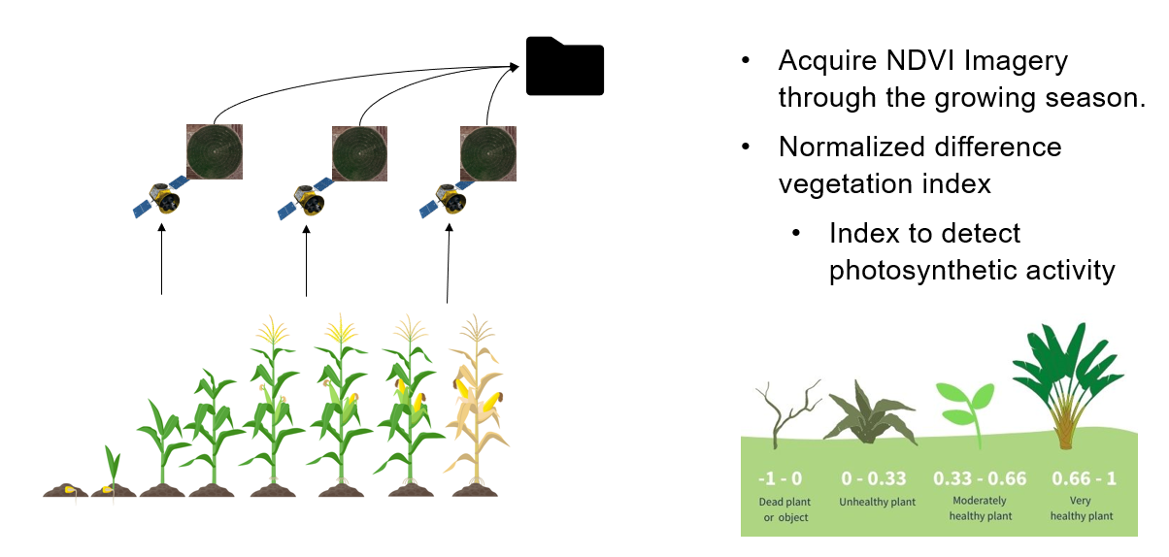
Satellite Imagery Overview
Agricultural Use Case

Slide 10
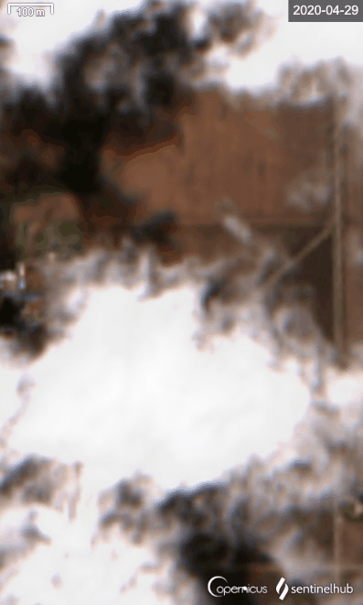
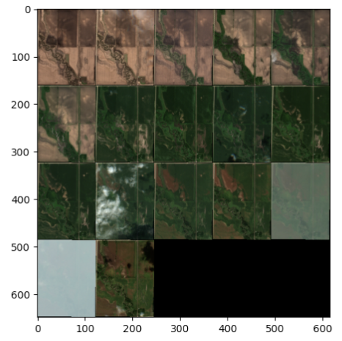
Satellite Imagery Overview
Challenges – Cloud Cover
Clouds block light – wrong values
Disrupts usual imagery schedule creating non-uniform data length and spacing
cloud
cloud

Slide 11
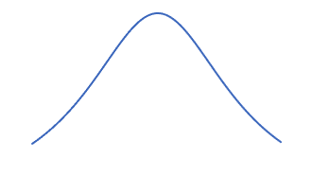
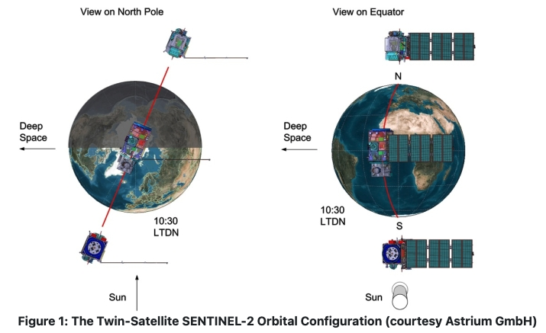
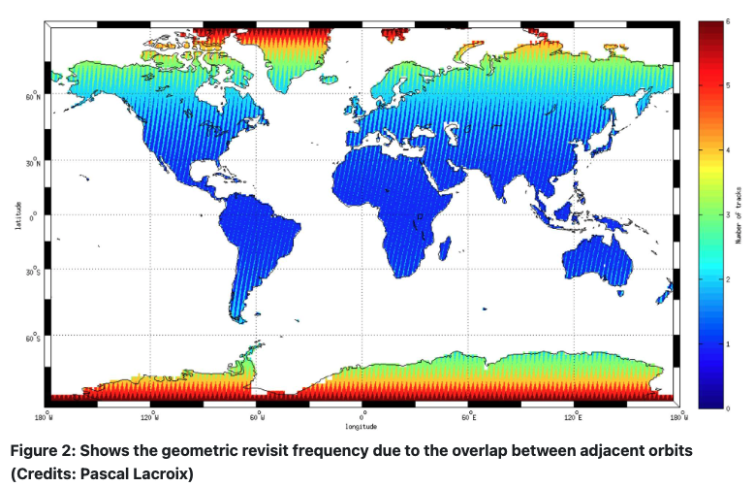
Satellite Imagery Overview
Challenges – Varying Temporal Resolution
NDVI
Satellite Orbits and schedules
Cloud Coverage
Data cleaning and processing
Days from Seeding

Slide 12
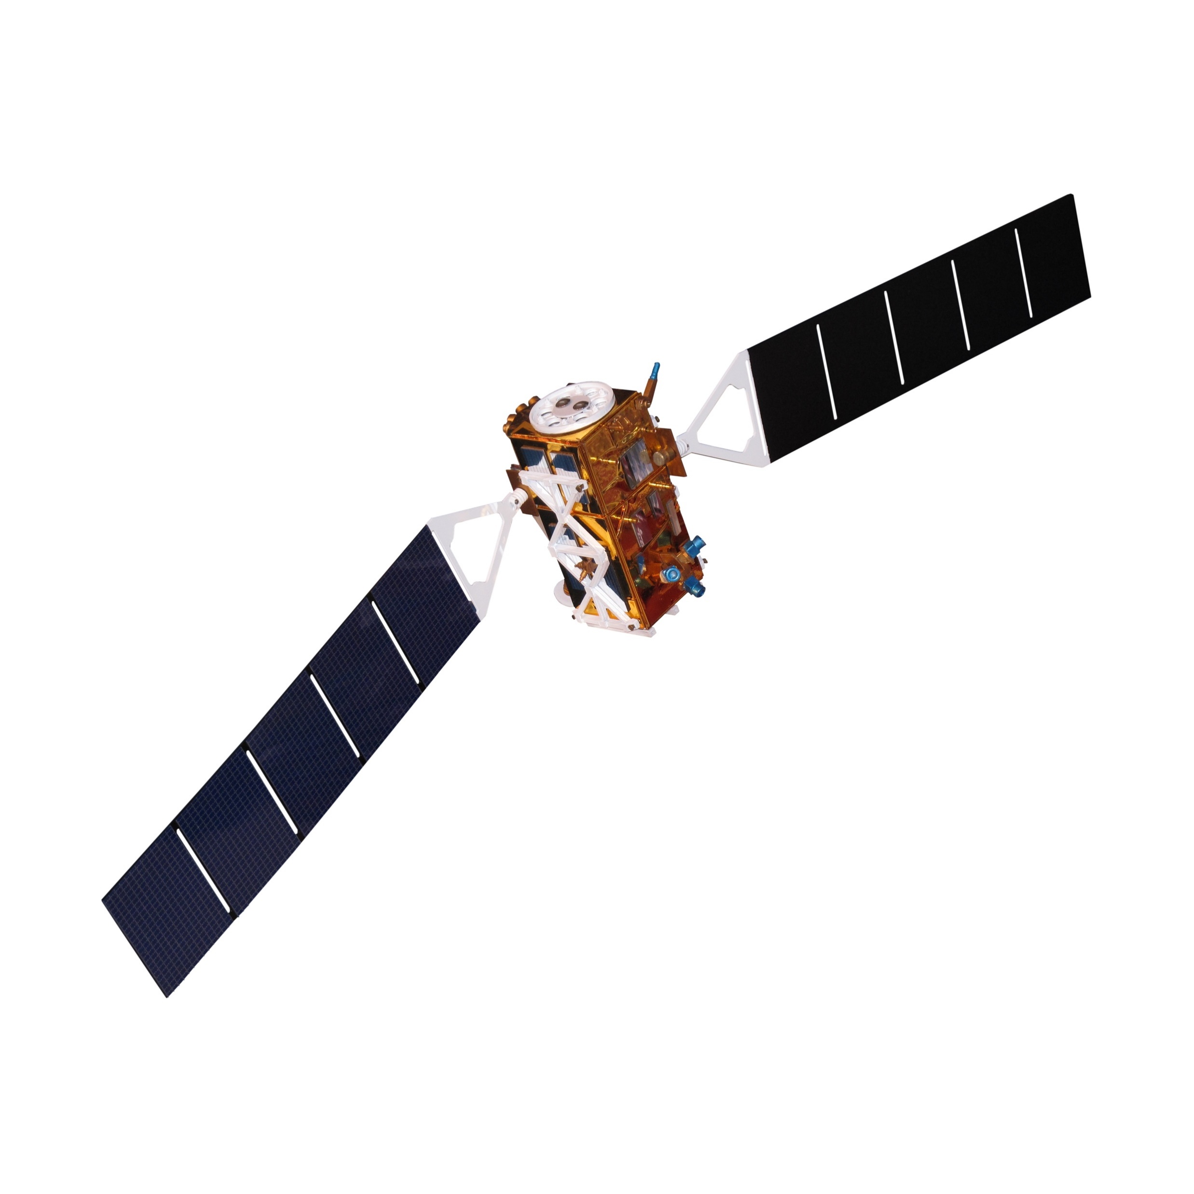
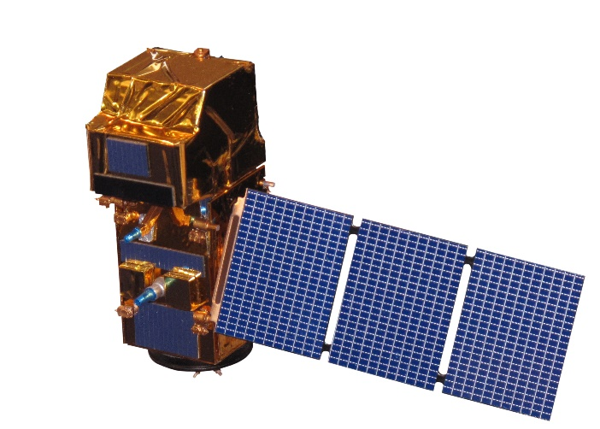
Available Free Satellite Imagery
Sentinel-1
Synthetic Aperture Radar
5 days temporal resolution
4 bands
5 meters resolution
Free
Sentinel-2
Optical
5 days temporal resolution
12 bands
20, 40 and 60 meters
Free

Slide 13
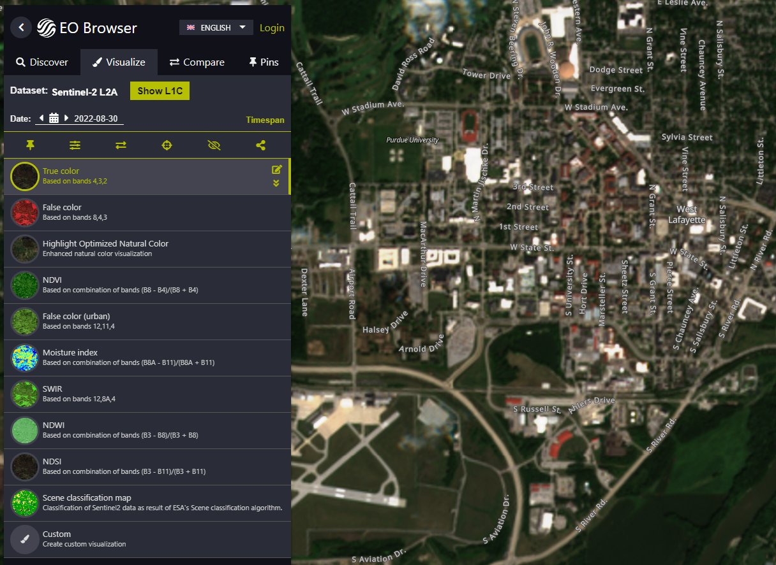

Ordering & Working with Satellite Imagery
Sentinel Hub
Satellite Imagery Service that provides a cloud data driver
Provides an API to order Satellite Imagery
Provides a GUI for browsing Satellite Imagery called EO Browser
https://www.sentinel-hub.com/

Slide 14

Ordering & Working with Satellite Imagery
Acquiring Satellite Imagery
Access to Sentinel-2 data is free
Stored in AWS S3 bucket
Searchable geospatially and temporally with Earth Search
Stored by individual bands in TIFF format
Can be downloaded locally

Slide 15
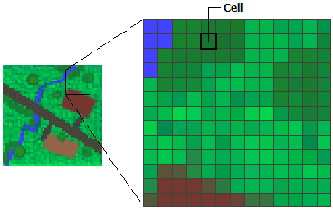
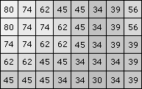
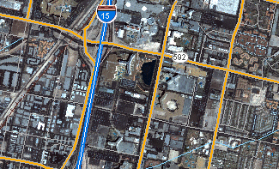
Ordering & Working with Satellite Imagery
Working with Raster Data
Satellite bands are formatted as Raster data
Raster data is a matrix of cells organized in a grid where each cell contains a value
In Satellite Imagery the value contained is the bands value inside that cell for the image
The cells or pixels are geospatially referenced
Images Credit: https://desktop.arcgis.com/en/arcmap/latest/manage-data/raster-and-images/what-is-raster-data.htm

Slide 16
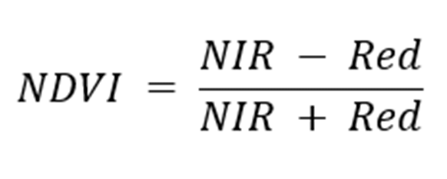
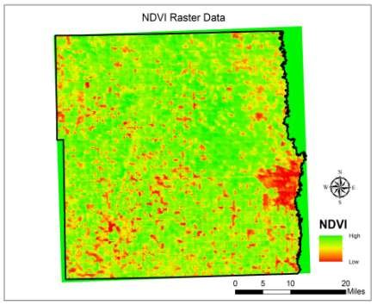
Ordering & Working with Satellite Imagery
Working with Raster Data – Band Arithmetic
The Raster format allows values across bands to be compared
Comparing values from different bands can make phenomena more apparent in imagery
NDVI is an example that makes vegetation stand out more in imagery
Image Credit: https://www.researchgate.net/figure/NDVI-data-in-Raster-form_fig5_332735913

Slide 17
DEMO
https://github.com/thompsonalexdeere/purdue-satellite-imagery-demo

Slide 18
Questions

